Slide 1

Welcome to today’s event:
Developing shared and equitable improvement approaches within provider collaboratives

Slide 2

Agenda
Welcome and context setting
Facilitated by chair, Jenny Reindorp - Director of Development and Engagement NHS Providers
Part 1:
Provider collaborative team introductions and initial reflections
Part 2:
Panel discussion
Part 3:
Interactive Q&A
Closing comments and end of session

Slide 3
Housekeeping
Please note, this event is being recorded
Please keep your camera on wherever possible
If you lose connection, please re-join using the link in your joining instructions or email provider.collaboration@nhsproviders.org
Please ensure your microphone is muted during presentations to minimise background noise
We will come to questions after each speaker
Please feel free to use the chat box for questions and sharing examples of what has delivered sustained progress in your organisation
If you would like to ask a question audibly, please use the raise hand function during the Q&A section and we will bring you in
Any unanswered questions will be taken away and answered after the event
You will receive a link to an evaluation form after today’s event. Please take the time to complete it, we really do appreciate your feedback.

Slide 4
Acute Hospitals Alliance
Emily Beardshall - Deputy Director, Improvement & Partnership, Great Western Hospitals NHS Foundation Trust

Slide 5

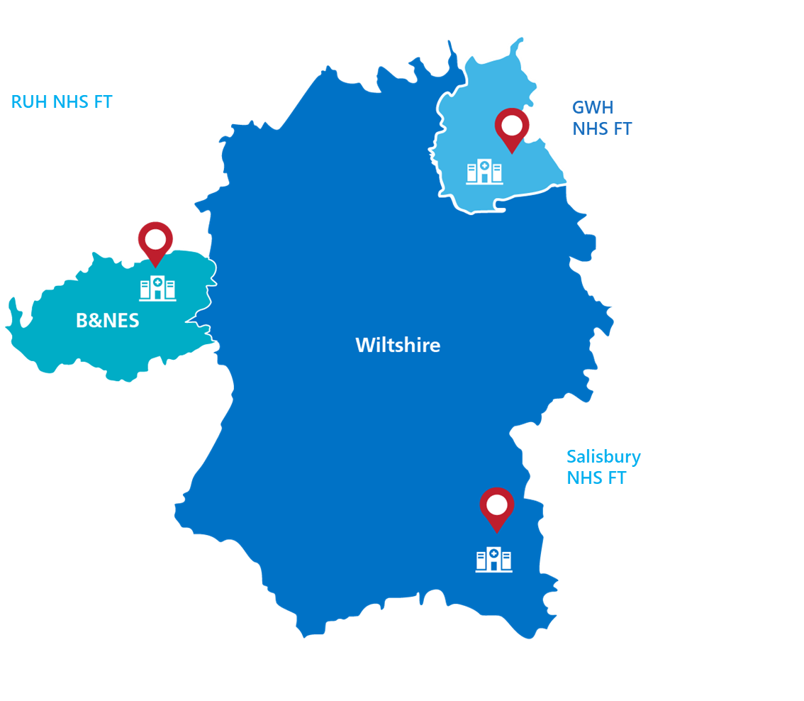
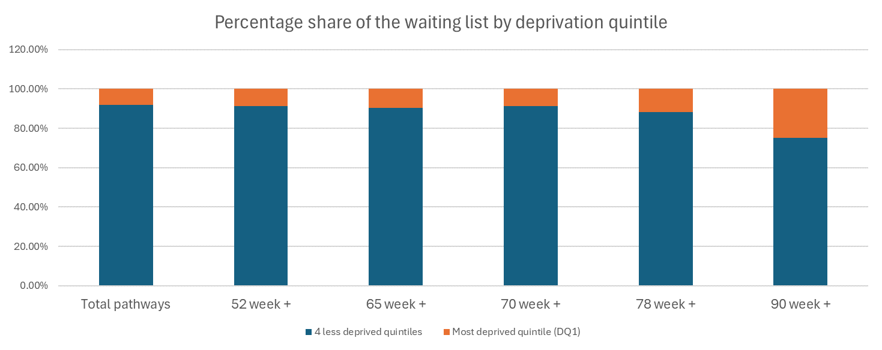
Bath & NE Somerset, Swindon & Wiltshire
Acute Hospital Alliance
Our provider collaborative was formed in 2018
3 acute/vertically integrated organisations serving a population of just under 1 million
We seek to reduce unwarranted variation; this includes improving access to services for our population
Our clinical strategy includes supporting fragile clinical services to support improved care and equity of care across the geography of our collaborative
Gastroenterology patients make up around 8% of all patients on elective waiting lists. When compared to other systems in the South West we have a higher proportion of long waiting gastroenterology patients (6.5% of patients are waiting longer that 52 weeks).

Slide 6
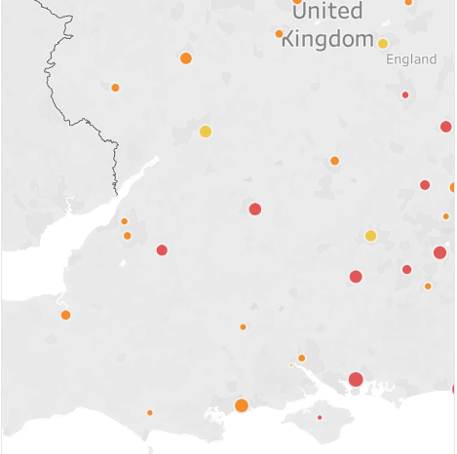
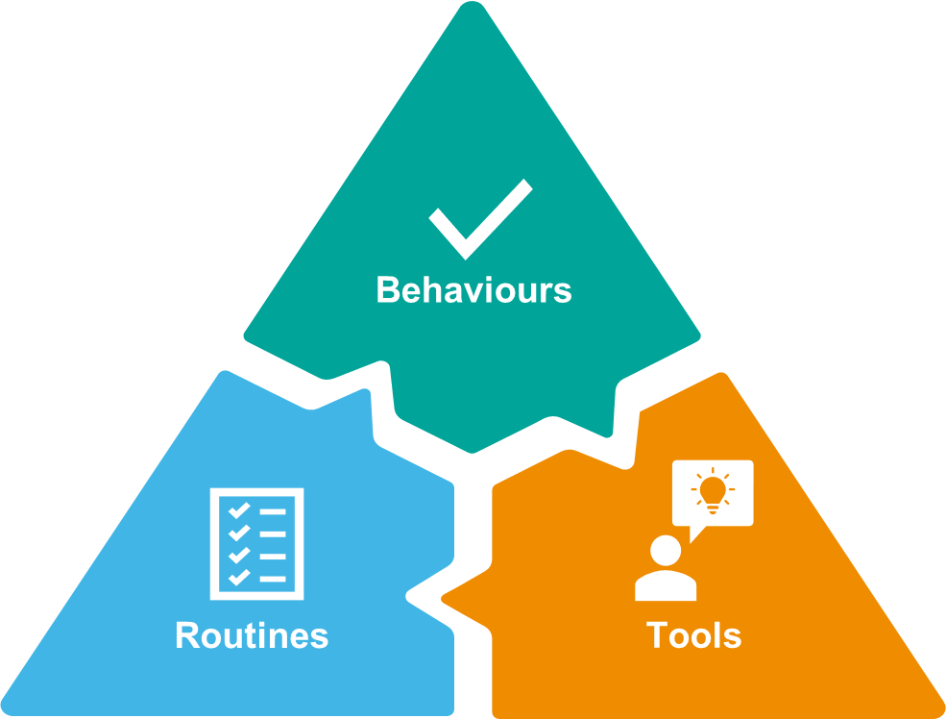
Reflections
Relationship building across collaboratives
  the importance of common ground,
  support from leaders across the group
Short term performance improvement vs longer term change
  use of structured problem-solving
  balancing the needs of partners
Establishing a case for change based on health inequalities
  difficulty in finding comparable data
  supporting data with lived experience of patients & staff
Operational Management Systems: working at group & specialty level simultaneously
  The importance of leadership behaviours at all levels

Slide 7
Joined Up Care Derbyshire
Tamsin Hooton – Provider Collaborative Programme Director

Slide 8

Provider Collaboratives: Improving Equitably
Primary Secondary Care Interface Work
NHS Providers Webinar 30th September 2024

Slide 9
Our collaborative and focus area:
JUCD Provider Collaborative
ICS level ‘all in’ collaborative formed in 2022
Includes 2 acute providers, community, mental health, ambulance and GP Provider organisations
Population of 1.2 million
Diverse populations and geographical coverage of collaborative members
Three priorities:
  Productivity and efficiency, continuous improvement approach
  Integrated care models with a focus on fragile services
  Corporate and back-office functions
Our focus and aims
Within broad area of productivity, chose primary/secondary care interface and developing single points of contact
OUR AIM
We aim to reduce the amount of time and effort that practices spend navigating the interface with secondary care on behalf of their patients
SO THAT
Safe, quality patient care is enabled in an efficient way and we release as much clinical time to offer care to our population as possible

Slide 10
Our progress and reflections:
Progress
Defined shared problem statement, aims and principles for what improvement will look like
All providers committed to implementing clear/single points of contact
Individual provider-led implementation groups
Collaborative team is linking the four implementation groups with PC:IE approach
Encouraging common improvement methodologies and shared approaches e.g. process mapping, theory of change, PDSAs, data collection
Reflections
Challenging to weave equity into our improvement focus
Don’t have any baseline data on current interface issues, contact volumes or demographics
Will build capture and analysis of HI into data from test improvements
Spent a lot of time getting right people together and really defining the problem we are trying to solve
Being clear on problem statement and what an improvement would look like is key
Balance consistency with flexibility in each provider

Slide 11
South Yorkshire Mental Health, Learning Disability and Autism Provider Collaborative
Rachael Deakin, Matron – Learning Disabilities & Forensic Directorate at Rotherham, Doncaster and South Humber NHS Trust

Slide 12



Slide 13
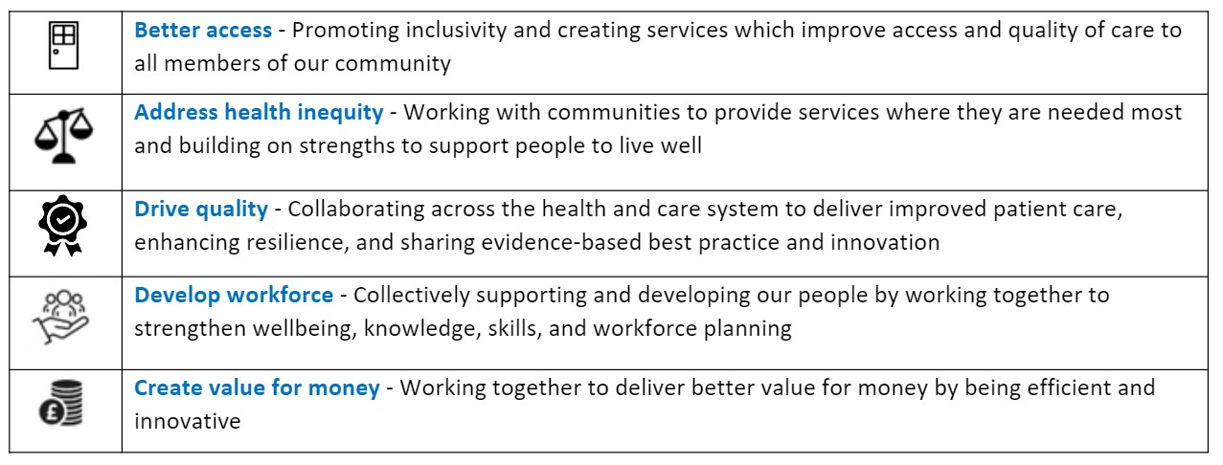
Our Strategic Work Programme
Stopping over medication of people with a learning disability and autistic people (STOMP)
Provision of all age eating disorders services
Health based place of safety (HBPOS)
Autism and ADHD assessment
Our Principles
We will collectively use our resources and expertise to improvement experience and outcomes for all
We will co-produce with people
We will always demonstrate mutual response, trust, open transparent communication and will act with integrity
We will share responsibility, accountability, risk and reward
We will be clinically driven and ensure services are locally owned
We will reduce health inequalities and deliver inclusive care and support
We will collectively support and develop our people
Our Strategic Objectives

Slide 14


Our Focus Area
STOMP AIM : Improving the quality-of-life people with a learning disability and/or autistic people through a standardised approach to assessing and managing behaviours of concern by optimising all non-pharmacological interventions and identifying the minimum effective doses of medication.
STOMP Principles & Pledge
Reduce the use of psychotropic medication
Holistic Care
Informed Decisions
Alternatives to medication
Regular medication reviews
Multi-disciplinary approach
STOMP principles and history “embedded”
Variable across the system
Wanted to connect services/teams - starting small
Learning about methodology – system level
Apply a quality improvement approach
NHS England

Slide 15
Progress & Reflections
Progress
Current state – STOMP audit, root cause analysis and driver diagrams, engagement
Engagement and coproduction with people with lived experience
Board level support of strategic direction
Connections – ICBs, Trusts and connections to other projects - HBPoS
System wide actions
Local tests of change
Reflections
Aligning South Yorkshire LD Services
Involvement & engagement – totally changed focus
Variable pace – meeting people where they are
Connections
Measurement
Understanding the data in relation to inequalities – drill down and what does this mean for the LD patient's
Understanding root causes
  Workforce
  Culture

Slide 16
Mid and South Essex Community Collaborative
Lianne Jongepier - Deputy Director of Transformation, Mid and South Essex Community Collaborative

Slide 17
Humber and North Yorkshire Collaboration of Acute Providers (CAP)
Lynette Smith, Deputy Managing Director, CAP

Slide 18
Any questions?

Slide 19


Slide 20


Tell us what you think
Scan here to access our evaluation or use the link in the chat

Slide 21
Thank you for attending

