Slide 1
Welcome
Can we talk about race?
September 2023
1

Slide 2
Agenda
Agenda
Welcome and introduction
Facilitated by chair – Sim Scavazza – non-executive director, Imperial College Healthcare NHS Trust and London North West University Healthcare NHS Trust (North West London Acute Provider Collaborative), and acting chair – Buckinghamshire, Oxfordshire and Berkshire West ICB
Fostering inclusion and the importance of leadership
Janine La Rosa – chief people officer, Barking, Havering and Redbridge University Hospitals NHS Trust
Psychological safety and the power of staff networks
Cherron Inko-Tariah – non-executive director and wellbeing guardian, Homerton Healthcare NHS, and vice chair, Seacole Group
Developing a culture of allyship and speaking up
Jane Nicholson – director of people, Berkshire Healthcare NHS Foundation Trust
Anti-racism approaches at system level
Andrew Kelso – consultant neurologist and medical director, South and North East Essex ICB
Panel Q&A
Facilitated by chair
Summary and close
Facilitated by chair
Close of event

Slide 3
Housekeeping
Housekeeping
Please note, this event is being recorded
Please keep your camera on wherever possible
If you lose connection, please re-join using the link in your joining instructions or email race.equality@nhsproviders.org
Please ensure your microphone is muted during presentations to minimise background noise
We will come to questions after all speakers have spoken
Please feel free to use the chat box for questions
If you would like to ask a question audibly, please use the raise hand function during the Q&A section and we will bring you in
Any unanswered questions will be taken away and answered after the event
You will receive a link to an evaluation form at the end of the day, please take the time to complete it, we really do appreciate your feedback.

Slide 4
The .O.W.E.R of Staff Networks
Tuesday 12th September 2023
CHERRON INKO-TARIAH MBE
www.thepowerofstaffnetworks.co.uk
@posnetworks

Slide 5
What we cover today
The role of networks
Psychologically Safe Spaces
AGENDA
The POWER of Staff Networks
Tap into the OWER

Slide 6
WHY DO WE STILL NEED EMPLOYEE NETWORKS?

Slide 7
The Role of Networks
Fix / Change something
Stop something
Start something
The POWER of Staff Networks
Tap into the OWER

Slide 8
Why are networks needed?
Diversity
?
Inclusion

Slide 9
NOT FITTING IN
STEREOTYPING
MICROAGGRESSIONS
NOT PROGRESSING
GASLIGHTING
ISOLATED
OVERLOOKED
The POWER of Staff Networks
Tap into the OWER

Slide 10
Networks bridge the gap by…
Representative Voice
Barriers
Safe Space
The POWER of Staff Networks
Tap into the OWER

Slide 11
What do we mean by safe space?
A place that provides a physically and emotionally safe environment for a person or group of people, especially a place where people can freely express themselves without fear of prejudice, negative judgment
Networks do this well because there is:
A shared affinity and experience
Willingness to be vulnerable
People feel included, seen, heard and believed
People trust the environment
The POWER of Staff Networks

Slide 12
WHAT DO WE MEAN BY PSYCHOLOGICAL SAFETY?
Psychological safety means feeling safe to take interpersonal risks, to speak up, to disagree openly, to surface concerns without fear of negative repercussions (McKinsey)
Senior leaders can take lessons from staff networks on creating safe spaces as a starter…
The POWER of Staff Networks
Tap into the OWER

Slide 13
The Empathy Gap
The Empathy Gap is a cognitive bias that causes people to be more empathic toward people in their ingroup than in their outgroup.
Essentially, this means that people are more likely to understand and share the mental state of those that they identify with and view as part of their social group.
Notes:
the outgroup empathy gap means that people are less likely to show empathy toward people who are of a different race or who have a different political affiliation.

Slide 14
Creating psychological spaces…
Empathy Gap
Make clear why employees’ voices matter - For most people, it feels safe to hold back and stay silent — Explain clearly and specifically why you need to hear from them, why their viewpoint and input matters, and how it will affect the outcomes of the work.
Admit your own fallibility - If you, as a leader, can own up to and demonstrate how you’ve learned from your mistakes, it paves the way for others. Practice proactive inquiry
Actively invite input - Don’t assume people will tell you what they’re thinking or that they understand that you want their input
Respond productively - You can tell people you want their input or it’s OK to make mistakes, but they won’t do those things if they feel like they’re being blamed or shut down. Also, replace blame with curiosity
The POWER of Staff Networks
Notes:
Admit your own fallibility - If you, as a leader, can own up to and demonstrate how you’ve learned from your mistakes, it paves the way for others. It’s important to model the behavior you want to see in your team and normalise vulnerability. This includes things like being respectful, open to feedback, and willing to take risks.
Respond productively - You can tell people you want their input or it’s OK to make mistakes, but they won’t do those things if they feel like they’re being blamed or shut down. Edmondson suggests asking yourself: When people speak up with a wacky idea or tough feedback, how do you respond? Be “appreciative and forward-thinking.” Also, replace blame with curiosity

Slide 15
Over to you

Slide 16
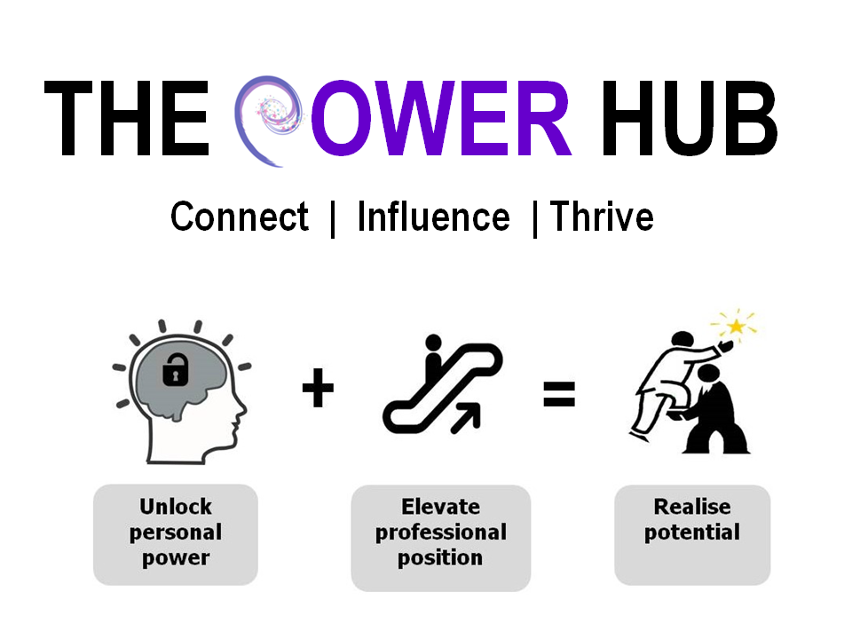
THANK YOU…Qs?
www.thepowerofstaffnetworks.co.uk
Info@thepowerofstaffnetworks.co.uk
 07943 108502
@POSNetworks

Slide 17
Can we Talk about Race?
Jane Nicholson

Slide 18
Anti-racism action statement
Berkshire Healthcare is committed to becoming an anti-racist organisation, in a purposeful and impactful way as part of our corporate strategy. We take an active role in identifying and addressing all types and impacts of racism, not just when it is obvious. | Our approach to achieving this includes: Making changes and taking positive actions that promote racial equity in all parts of our organisation. Allocating resources to support our anti-racism agenda and monitor progress. Supporting and encouraging our colleagues and community to actively participate in anti-racist practices. Regularly and openly communicating our commitments and progress.
The Board holds the responsibility for leading our anti-racism efforts and ensuring measurable objectives are achieved. We firmly believe that anti-racism activity should not be solely placed on racialised groups. Instead, we embrace actively involving our Race Equality Network, colleagues, and communities to make meaningful change.

Slide 19
What is allyship?
Looking at the journey and purpose of allies
Sharing your equality information makes scrutiny possible!
Structural
Interpersonal
Impact - redesigning processes and practices that maintain unequal outcomes
Purpose and co-ordination – speaking out and advocating
Cultural
Unity - proactively set expectations, listening and learning from representative voices to adopt new thinking
Internalised
Intentions – personal growth to increase your capacity and competence for action
Join a staff network

Slide 20
Toolkit ideas
Interrupting
I find that uncomfortable. Those aren’t our values
Help me understand what you mean
How might the impact of your words or action differ from your intent?
I don’t find that funny. Tell me why that’s funny to you?
Why do you believe that to be true?
Responding
I didn’t realise, thanks for correcting me
I’ll look into this some more, thanks for telling me
I hadn’t thought of it that way, thanks for helping me understand
I didn’t know that before, I will reflect and rethink things

Slide 21
Responding
Listen
Breath slowly to help you control your verbal and non-verbal reaction. No need to instantly respond.
Acknowledge your feelings. Perhaps surprised or scared. Give yourself time. Avoid defensiveness, excuses or insults.
Learn
Reflect and look into the topic. Ask for clarity if that is appropriate. Try not to dwell, it distracts from learning.
Mistakes happen. You can’t know everything. Positive affirmations can help you navigate context. Accept you are an ever changing person.
Act
Even when poorly delivered it can be difficult for them and you can learn from their delivery. Avoid emotional caretaker.
Use the feedback to avoid a similar experience. Thank the person apologise if you hadn’t realised the harm.
Adapted from Castrillon and Eurich
Notes:
Self image threatened

Slide 22
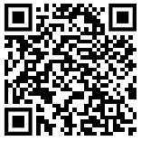
Upcoming events
Book now:
Tackling inequalities to build a healthy workforce
Monday 11 December 2023 | 12.30pm-2.00pm
Speakers will share initiatives that have positively impacted population health by addressing health inequalities in the workforce.
Scan here to access our
upcoming events
22

Slide 23
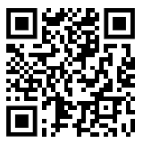
Evaluation
Tell us what you think
Scan here to access
our evaluation
23

Slide 24
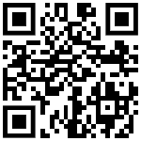
Marketing
Visit our website for further topics on race equality, including:
Inclusive recruitment and talent management
Data and accountability
Allyship
Health inequalities
Internationally educated workforce
Scan here to access our website
24

Slide 25
Evaluation
Thank you
Scan here to access
our evaluation
25

