Slide 1

Establishing
provider collaboratives
David Williams
Head of policy and strategy
25 November 2022
Notes:
Me, plus purpose of the session and what we’re going to talk about

Slide 2



What I’m going to talk about
Status update: November 2022
Governance arrangements
Enablers
Development and vision
NHS England support
Takeaway points

Slide 3
Provider collaboratives: development and vision
Clinical networks, shared support services and joint procurement are well established.
Pandemic leads to rise in mutual aid between providers - 2020
Permissive legislative framework established in 2022 Health and Care Act
Collaboratives positioned to become drivers of improvement, quality and value in their systems
Dalton Review proposes group model - 2014
Notes:
Policy background
Providers collaborating is not new: procurement at scale for many years; NHSI pushing pathology networks; clinical services long networked; group models following the Dalton review in 2014.
Collaboration accelerated in the pandemic – because a common task to tackle (Covid) and common problems (eg supply chain, capacity) best handled together; saw growth in mutual aid (eg over PPE and other supplies). Not a coincidence that this joint working was supported by a suspension of the normal finance and regulatory regimes.
What does legislation and guidance say? Legislation – not much: enables joint cttees for providers and ICBs and NHSE CHECK THIS, and enables NHSE and ICBs to delegate functions and budgets. CHECK Point is that the fmwk is open and permissive.
LEO: could add a node to acknowledge that the NHS-led provider collabs for MH services took shape prior to the bulk of collabs (around 19/20 I think)?
The intention is, in the wider context of system working are that collabs are one option for driving improvement through collaboration and cooperation – that they can do things that trusts alone cannot by operating at scale. And, because they are better placed than ICBs to take decisions about improving services, they will be able to take functions and budgets to run service lines or entire sets of services.
Guidance – Provider collabs toolkit – set out considerations for trusts, governance models.
Planning guidance 2021 – expectation all acutes and MH trusts are in a collab, and ambo and community where it makes sense.
LEO: On the guidance point, prior to the toolkit there was the August 2021 paper which set out some detail on what collabs would do as part of ICSs (here). Don’t think there’s any material detail that you need to add from that.
IZZY: As Leo says – joint committees and pooled funds apply to joint exercises by relevant bodies (NHSE, ICB, FTs/trusts), and they may include local authorities and combined authorities so joint committees/pooled funds between providers/ICBs and LA or CAs are also allowed.

Slide 4
Governance arrangements
Lead provider
One trust holds contract from commissioner
Shared leadership
Trusts share some executives
Provider leadership board
Joint forum bringing together members’ leaders
May take decisions on behalf of member trusts
Lead contractor sub-contracts to other providers
Separate boards and leadership capability retained for each trust
Remember:
Provider collaboratives are not corporate entities; don’t have balance sheets; legal duties and liabilities will remain with trusts and ICBs.
They have no independent resourcing.
NEDs roles on ICBs and trusts unchanged – corporate oversight you bring remains very important.
Provider collaborative membership
“All in” type – all providers in an ICS
Sectoral type – focused on MH, acute, etc
Some collabs include non-trust partners eg charities
Notes:
Different governance models – set out in toolkit at the beginning of 2022 –
Lead provider – contractual model
Shared leadership – meaning joint apptments
Provider leadership board – phrase NHSE have used but it’s not a board really in the way you’ll understand it – could be more of a forum or a joint cttee.
The above not mutually exclusive and some trusts will be in more than one.
NOTE IZZY POINT FOR VOICEOVER - collaboration bandwidth issue – NEDs should be aware of the capacity stretch execs/Chairs may be experiencing.
Anecdotally for voiceover seeing different trends in different parts of the country – it’s not completely perfect but eg we’re seeing the group model emerge as the favoured option in London – we know ppl in other parts of the country are feeling like they’re being encouraged to take one form or another – so anecdotally we are hearing NHSE taking an interest.
For ICBs and trusts, NEDs role remains the NEDs role – the existence of provider collabs, which have no legal standing, doesn’t change that.
So for trusts and ICBs the value you bring lies in being not a subject matter expert, helping the board set its strategic approach, identifying risk and promoting good practice, offering support and challenging the exec. Asking probing Qs to seek reassurance. Governance issues affecting collabs.
A collab is not a body corporate in law. And therefore everything one does, the ICBs and/or trusts will always bear the legal or regulatory accountability for.
Note: there’s no dedicated resourcing – so can only be resourced from existing trust or ICB mgmt budgets
IZZY : I don’t know if it’s adding too much complexity but may be helpful to remember that the legislation (65Z5(6)) specifically attempts to push liability for any delegated functions to the body receiving the delegation:
(6) Any rights acquired, or liabilities (including liabilities in tort) incurred, in respect of the exercise by a body of any function by virtue of this section are enforceable by or against that body (and no other person).
Hence caution about accepting delegations – or at least the need to have eyes wide open when doing so. May be useful for Q&A perhaps.
Hearing about two main approaches: one is sectoral – eg MH, acute, specialist – the other is “all in” – linking sectors within the ICS geography.
Some –are flexing the model to bring in non NHS partners eg charities, LAs – or align around themes like CYP rather than sectors or geographies.
Expect collabs to take different roles and forms in different ICSs – different ICSs will have different providers, different population needs, different levels of capability/maturity and will want to do different things at place level.

Slide 5
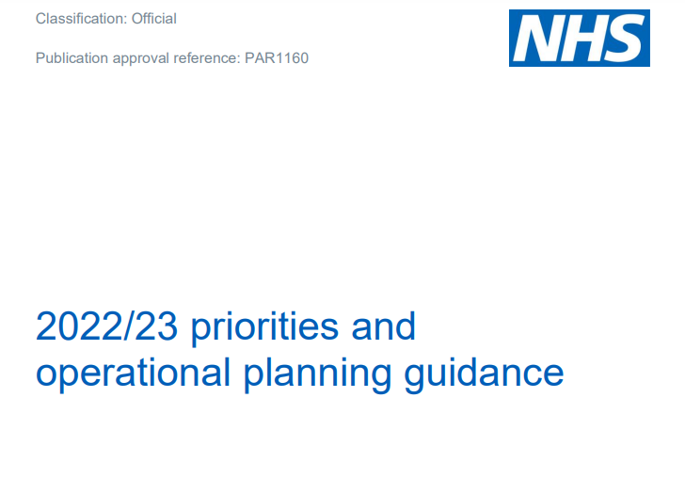

Collaboratives in November 2022
Areas of focus
Reducing variation in outcomes and access
Consolidating services to improve quality/sustainability
Economies of scale to improve value
Sharing backlog recovery
Recruitment/retention strategies
Tackling health inequalities
Planning guidance 2022: Tasks for collaboratives around virtual
wards, inpatient MH services and CYPMH planning.
Notes:
Tasks
Planning guidance 2022 – collabs asked to work on planning for rapid rollout of virtual wards. MH ones to transform approach to inpt admissions and plan for CYPMH to meet population need. Nothing interestingly on elective recovery – possibly MH ones judged to be more mature at this stage.
What we hear about priorities and functions (at this early stage) eg reducing variation in outcomes and access; tackling HI; sharing backlog recovery, improving services/quality via consolidation, efficiency savings/better VFM via economies of scale, recruitment/retention (joint workforce mgmt.)
IZZY POINT Maybe possible to hammer home a bit more that collabs should be trying to solve defined issues to ensure focus/value.

Slide 6
Enablers
Collaborative leadership
Shared ambitions/
purpose
Form follows function
Build capacity to deliver
Support staff
Build trust at board level
Clinical leadership
Notes:
Enablers:
Modelling collaborative leadership behaviours
Shared ambitions/purpose
Build trust at board level between orgs
Clinical leadership
Start with strategic direction – then decide form to follow function
Build capacity to deliver programmes
Support staff – human factors matter
IZZY POINT:
Maybe possible to hammer home a bit more that collabs should be trying to solve defined issues to ensure focus/value.

Slide 7
NHS England support
Maturity matrix
Purpose: a tool for local use to show what good looks like.
Unclear whether it will be optional or compulsory
Testing with collabs this winter.
Due: New year.
Innovation accelerators
Purpose: understand development needs, source support, and capture learning.
Cohort of around eight collabs spanning all regions, sectors, and stages of development.
Expressions of interest due 9 Dec; cohort selected by Christmas.
Notes:
Maturity Matrix. Purpose: to show what good looks like across a range of factors. NHSE say it will be a tool for local use not a compliance/assessment exercise. Unclear whether it will be compulsory. Could support peer learning. Testing with members (facilitated by NHSP) this winter. When due: New year.
Innovation accelerators. Purpose: work with about 8 collabs across the country and at various stages of development. Understand development needs and source support, then capture learning. Expressions of interest by 9 Dec. Select the final cohort before Christmas.
LEO: Just on the innovators cohort, is it worth noting that the criteria for those is: i) delivering long-term transformation and ii) driving improvement for challenged/fragile services/organisations (with the second of those being worth noting re the envisaged role of collabs going forward)?
IZZY: Agree that point is that the framework (in legislation) is permissive – but ‘maturity matrix’ is likely to set tone for what’s considered at least good practice if not actually permissible… general point (well-made in a session at ACE) that while the legislation provides for great flexibility as time moves on NHSE’s tendency is to effectively restrict such freedoms through guidance/exemplars etc… so get in quick was the message given there!
(therefore WE HOPE this stays within the spirit of permissiveness re the act – and NHSE resist temptation to turn it into a standardisation process)

Slide 8
Takeaway messages
Collaboration has been developing for years: therefore aims and maturity vary
Vision is for collaboratives to play a key leadership role locally
Governance: options are available but careful thought is needed
Enablers centre on human factors and agreed vision
Collaboratives already ambitious to lead improvement in their systems
Notes:
LEO: Couple of thoughts on final macro take aways: 1) is it worth noting that some collabs have been around for a while (eg WYAAT and GMPFB) and some are quite new? 2) also is it worth noting that there appears to be a level of enthusiasm at national level for collabs to play a leadership role in system delivery?

Slide 9
THANK YOU
david.williams@nhsproviders.org
Notes:
LEO: Couple of thoughts on final macro take aways: 1) is it worth noting that some collabs have been around for a while (eg WYAAT and GMPFB) and some are quite new? 2) also is it worth noting that there appears to be a level of enthusiasm at national level for collabs to play a leadership role in system delivery?

