Slide 1

HEALTH AND CARE:
THE CHALLENGES
AHEAD
Nhs providers
Governor focus conference
Chris Hopson
Chief Executive
6 JULY 2021

Slide 2



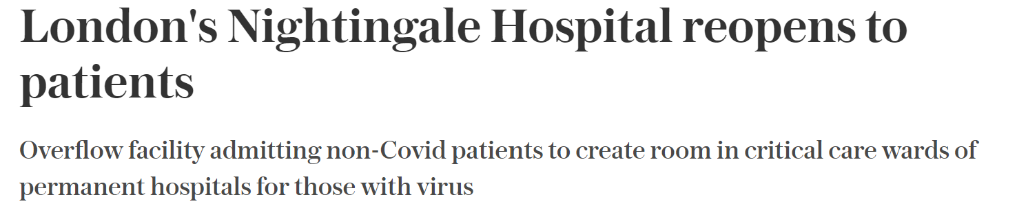
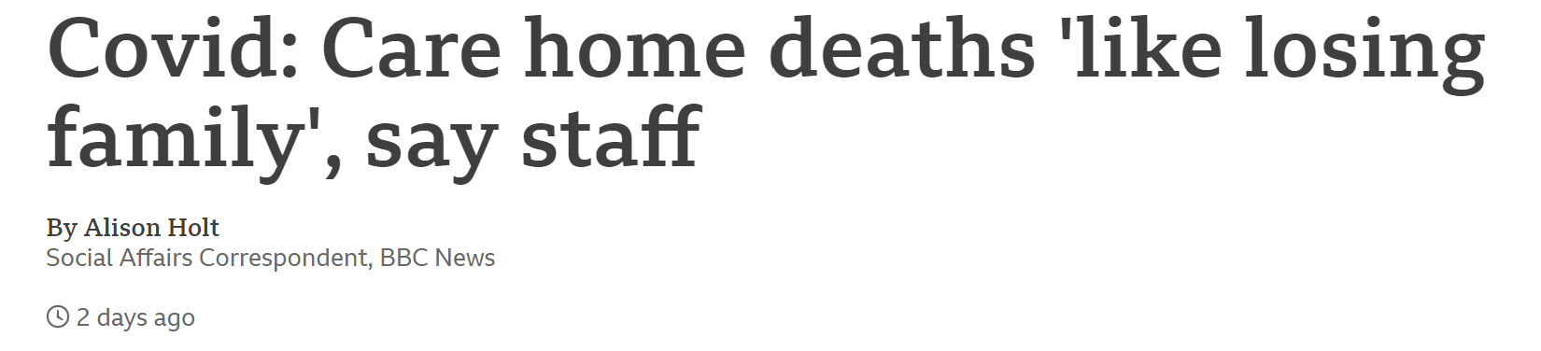

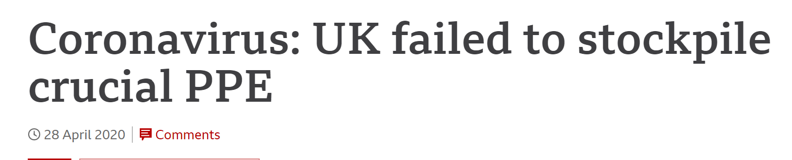

An extraordinary 16 months: nine lessons learnt?
  NHS/wider health and care system is capable of much faster and more extensive change than we might have previously thought
  COVID forced much more rapid, consistent and successful vertical “place based” and horizontal “system based” collaborative working
  Empowering front line NHS leaders within clear strategic objectives and stepping back from top down command & control worked too
  The SARS-CoV2 virus will be with us for a long time to come – we have barely begun to think about what that means
  Living with the virus long term and coping with consequences of last 16 months will bring major new pressures
  We had a serious capacity / demand mismatch before COVID struck. It’s a lot worse now.
  Our staff were magnificent but current workforce model is unsustainable with no immediate solution available
  A crisis always finds the most vulnerable and weakest links in the chain: our social care system is unsustainable too.
  COVID-19 seriously exacerbated health inequalities. Tackling those inequalities offers the potential for a powerful unifying mission.

Slide 3
A huge amount now going on…and to come over next 9 months
Now
New Secretary of State
Next 9 months
Spending Review prioritisation
New NHS England CEO
Multi-year backlog recovery plan
Difficult winter: more C-19 & flu?
NHS Bill and moving to system working
Busy Urgent/Emergency Care
Full pelt backlog recovery
Rapidly increasing demand meets restricted capacity
Staff recovery and wellbeing
COVID-19 Delta variant spread
COVID-19 vaccinations
Money negotiation for second half of year
Getting back to fixed budgets

Slide 4
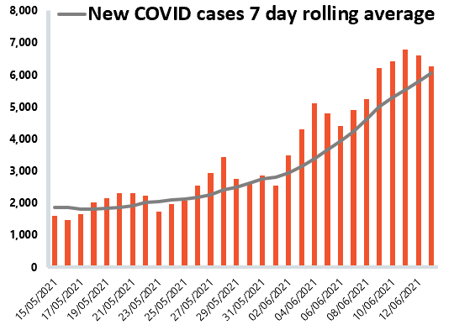
Growing pressure on all fronts
Continuing COVID-19 pressures
Delta variant translating into increasing hospitalisations, but lower than before
Increasing concern about long COVID
Growing backlog
Growing backlogs across physical and mental health care services
Rising UEC demand
High pressure on A&E and ambulances – record levels in multiple places:
* Bounce-back
* Acuity
* Perceptions of ease of access to primary care
Elective care waiting list exceeds 5 million
Growing concerns about cancer backlog and delayed diagnosis
Diagnostic capacity a real pinch point impacting on different pathways
Concern about numbers and complexity of mental health presentations
NHS Providers survey of mental health service trust leaders:
100% said demand for CYP services is significantly or moderately increasing compared to six months ago
85% said they could not meet demand for CYP eating disorder services – the highest result across all services
Notes:
Top lines:
The elective care waiting list has increased to 5.12 million, the highest level on record.
Trusts are now carrying out 95% of elective care activity against the 2019 baseline, exceeding the target of 75% set out by E/I in the 2021/22 planning guidance.
52 week waits have decreased for the first time in 24 months (50,637 fewer) - now at 385,000
A&E Activity continues to increase as A&E attendances reach the highest figure since January 2020.
Ambulance activity has also increased considerably - with 10% more incidents than April 2019.
Ambulance category 1 target has been missed for the first time in 3 months.
More than 200,000 people had an urgent referral for a suspected cancer - exceeding pre-pandemic levels (but down on the all time high last month).
The number of diagnostic tests carried out has decreased on last month (-4.4%) but remains higher than in April 2020 (+201.8%) but still falls short of the numbers seen in April 2019 (-3.6%).
The number of OAPs has decreased to 700 but remain considerably higher than last year.
Mental health referrals have increased by almost a quarter on last month.
NHS 111 and ambulance
Activity:
Ambulance: Ambulance cat 1 incidents increased by 16.7% to 67,982 since the previous month (9,728 more incidents). Compared to May 2019, incidents have increased by 17.7% (10,231 more incidents). Compared to April 2020 (first wave of the pandemic), incidents have increased by 39.3% (19,185 more incidents). Compared to January 2021 (second wave of the pandemic), incidents have increased by 10% (6,155 more incidents) and compared to may 2019, incidents have increased by 10.2%.
111: 88.5% of the calls received by 111 were answered. This means 1,662,056 of the calls 1,877,854 calls received were answered. Due to NHS 111 changing the way data is collected, the figures are no longer comparable.
Performance:
The mean average response time across England in May 2021 for Category 1 missed the 7-minute target for the first time in 3 months at 7 minutes 25 seconds. However, compared to the peak in March 2020 (8 min 7 secs), this is slightly better.
The average response time for Category 2 continues to deteriorate as it misses the 18 minutes target at 24 minutes 35 seconds. However, this remains a significant improvement compared to the peak in March 2020 (32 min 6 secs).
A&E
Activity:
Emergency care activity continues to increase again this month reached the highest number of attendances since January 2020.
In May 2021, there were 2.08 million A&E attendance this is the highest figure since January 2020 and up by 11.2% on last month, up by 64.9% on last year but down by 4.3% on May 2019.
There were 543,754 emergency admissions in May 2021. This is up by 6.6% on last month, up by 36.5% on last year and down by 0.7% on May 2019.
Performance:
Performance against the 95% drops further from last month’s figure of 85.4% to 83.7%. This is also down considerably from last year’s figure of 93.5% and down from the 86.6% figure in May 2019.
The performance against the type 1 target falls further from 78.8% last month to 76.5%. This is also down from the 91.2% target last year and down from the 79.1% figure in May 2019.
The number of patients waiting longer than 4 hours has increased this month by 17.6% to 57,307 (8,588 more). The number of patients waiting more than 12 hours has increased by 32.7% on last month to 694 (171 more).
April 2021 data
Diagnostics
Activity:
The number of tests carried out in April 2021 has decreased by 4.4% to 1.84 million (86,039 fewer). However the number of tests carried out has increased considerably when compared to April 2020, with 201.8% more tests carried out (1.23 million more). Compared to April 2019, there were, 3.6% fewer tests carried out (69,794 fewer).
The number of MRI, CT and colonoscopy tests have all decreased this month (-6.6%, -3.1%, -9.0%). Compared to April 2020, these have all increased considerably (+211.4%, +99.7%, +1226.8%). However compared to April 2019, the number of MRI tests carried out has decreased (-5.3%) but CT scans and colonoscopy scans have increased (+10.4%, +6.5%).
Performance:
The diagnostic waiting list has increased by 3.0% 1.29 million (37,626 more) on last month. This is up by 53.8% on last year (452,442 more) and up by 22.7% on April 2019 (238,964 more).
24.0% of people were waiting six weeks or more for a test in April, down slightly from 24.3% last month and missing the 1% target again this month.
RTT
Performance and waiting list:
In April 2021 the size of the elective care waiting list increased by 171,720 to 5.12 million - a 3.5% increase since March 2021. The waiting list is bigger than it has been over the last 10 years/when this data set began.
The size of the waiting list is 30% greater than a year ago during the first wave of the pandemic.
In April 2021, the number of patients waiting more than 18 weeks increased by 2.8% - an additional 48,554 patients rising to 1.8 million.
Performance against 18 weeks standard remains stable, improving by 0.02%, with 64.6% of people waiting less than 18 weeks.
The number of people waiting over 52 weeks has decreased for the first time in 24 months. The number of long waits fell by 50,637, to 385,490. This is a decrease of 11.6% from March 2021 when there were 436,127 people waiting over 52 weeks in February. When compared to a year ago the number has increased by 3391%.
Activity:
Inpatient elective care activity has increased again in April 2021 picking up since the January wave. Trusts are now carrying out 95% of elective care activity against the 2019 baseline, exceeding the target of 75% set out by E/I in the 2021/22 planning guidance.
The number of admitted inpatient pathways increased by 1.6% compared to March with numbers rising from 220,349 to 223,780.
Numbers of admitted inpatient pathways are back to levels seen before the January wave.
Non admitted pathways slightly decreased in April from March. In April 2021, the NHS delivered 933,478, down from 1,013,328 elective non-admitted pathways the month before – a 7.9% decrease. However numbers are still higher than during the pandemic apart from the previous month.
Cancer
Activity:
Cancer activity dropped from the high the previous month but remains at pre-pandemic levels for another consecutive month.
209,452 people were seen within 2 weeks of an urgent referral for a suspected cancer- this is down from the previous month which saw the highest number on record (232,084). Therefore, the decrease (9.8%) should be taken in that context and is still higher than pre-pandemic levels.
24,963 people completed the 31 day pathway which aims for one month between starting treatment and the decision to treat. This was 2,766 lower than the previous month when activity was high – a decrease of 10%. However, this remains 24% more activity than a year ago.
Those on the 62 wait from urgent GP referral to starting first cancer treatment pathway also decreased on the previous month but still remains higher than during the pandemic. 13,139 people completed the pathway, a decrease of 10.5% from the month before but a 22% increase from a year ago.
Performance:
Although activity is at pre-pandemic levels, performance against the waiting time standards has slipped slightly meaning the NHS is missing all key national targets.
2 week wait – 85.4% of urgent GP referrals were seen within to weeks. This is a decrease on last month’s 91% and misses the 93% standard.
31 day wait – 94.2% of people started treatment within one month of the decision to treat, down ever so slightly from 95% the previous month, but falls short of the 96% standard.
62 day wait – a slight increase with 75.4% of the people who started treatment did so within 62 days of their urgent GP referral, up from 74% the previous month but misses the 85% standard.
Mental health
Activity:
In March 2021, mental health referrals increased by 24.1% to 404,552 (78,690 more referrals). Compared to March 2020, referrals have increased by 36% (107,036 more referrals). Compared to April 2020, referrals have almost doubled (up by 93.7%, 195,723 more referrals).
The number of people in contact with mental health services have increased by 2.2% to 1,410,000 (30,000 more people in contact). Compared to the same time last year, there are 2.2% more people in contact with mental health services (29,760 more people). Compared to the peak in April 2020, there are 8.2% more people in contact (106,362 more people).
In March 2021, there were 2.20 million care contacts attended (down by 14.6%, 280,000 fewer than the previous month). In comparison to the same time last year, care contacts have increased by 21% (381,645 more). Compared to April 2020, there are now 23.3% more care contacts attended (416,300 more care contacts).
Performance:
In March 2021, the number of out of area placements decreased to 700 (90 fewer OAPs). Compared to a year ago, OAPs have increased by 23.9% (135 more OAPs). Compared to the peak in the first wave in April 2020, there are now 245 more OAPs.
Children and Young People with an Eating Disorder - 70.5% of patients started urgent treatment within one week in Q4 2020-21. This compares to 80.5% in Q4 2019-20 and 80.6% in Q4 2018-19.
Children and young people's mental health survey
In recent years there has been progress in improving mental health services, including significant investment. However, many trust leaders have expressed their concern about how long children and young people are currently waiting for care, reporting large increases in demand for mental health services. NHS Providers submitted evidence to the ongoing Health and Social Care Select Committee’s inquiry into children and young people’s mental health services.
Key findings include:
100% of mental health trust leaders said that the demand their trust/local systems is experiencing for CYP services is significantly (80%) or moderately (20%) increasing compared to six months ago.
85% of trust leaders said they could not meet demand for CYP eating disorder services – the highest result across all services.
Two thirds of trusts leaders said they are not able to meet demand for community CAMHS (66%) and inpatient CAMHS services (65%).
84% of trust leaders said the amount of time children and young people are currently having to wait to access treatment for services is significantly (25%) or moderately (59%) increasing compared to waiting times six months ago.
78% of trust leaders said they are extremely (47%) or moderately (31%) concerned about their trust/local system(s) ability to meet the level of anticipated demand within the next 12-18 months for mental health care amongst children and young people.
83% of trust leaders are extremely (37%) or moderately (47%) concerned about staff wellbeing and current levels of stress and burnout across their CYP services workforce.

Slide 5
The scale and width of forward challenge….
Delivering the Long Term Plan including inequalities
Living with COVID
Clearing the care backlog
Making our workforce model sustainable
Moving to system working
Reforming social care
Making NHS money work
The biggest challenge of the next phase is the sheer scale and width of what needs to be delivered

Slide 6

Getting back to delivering the NHS Long Term Plan
Tackling health inequalities, importance now significantly heightened as a result of COVID-19 impact
Investment in primary medical and community services to grow faster than NHS budget; additional £4.5bn a year in real terms by 2023/24; GP practices required to join primary care networks
Sustaining and better tracking of MH investment
Preventative focus on the causes of early mortality and whole population health management
Improving outcomes for children and disease groups: cancer, diabetes, cardiovascular, respiratory, stroke, MH
Ambitions to back and grow the workforce and tackle the implications of Brexit and immigration policy
Mainstream digital access to care
Balance NHS books, including for providers, and delivering efficiencies
Roll out of ICSs across the country and fully embedding system working and integration of health and care

Slide 7

Living with COVID-19 Longer Term
Rapid, effective, widespread surveillance including large scale, sophisticated test and trace:
    Complete geographic coverage
    Tracking variant spread
    Ability to react at pace
Annual(?) vaccination campaign
Long COVID, mental health and COVID created demand
Impact on long term health
Ability to flex for more COVID waves & maintain care
    Physical configuration
    Staff training
    Pinch points
Absorbing loss of capacity from infection control
Much more demand and new types of demand
This will require:
    Re-configuration of NHS and public health shape
    More £ and people than planned

Slide 8

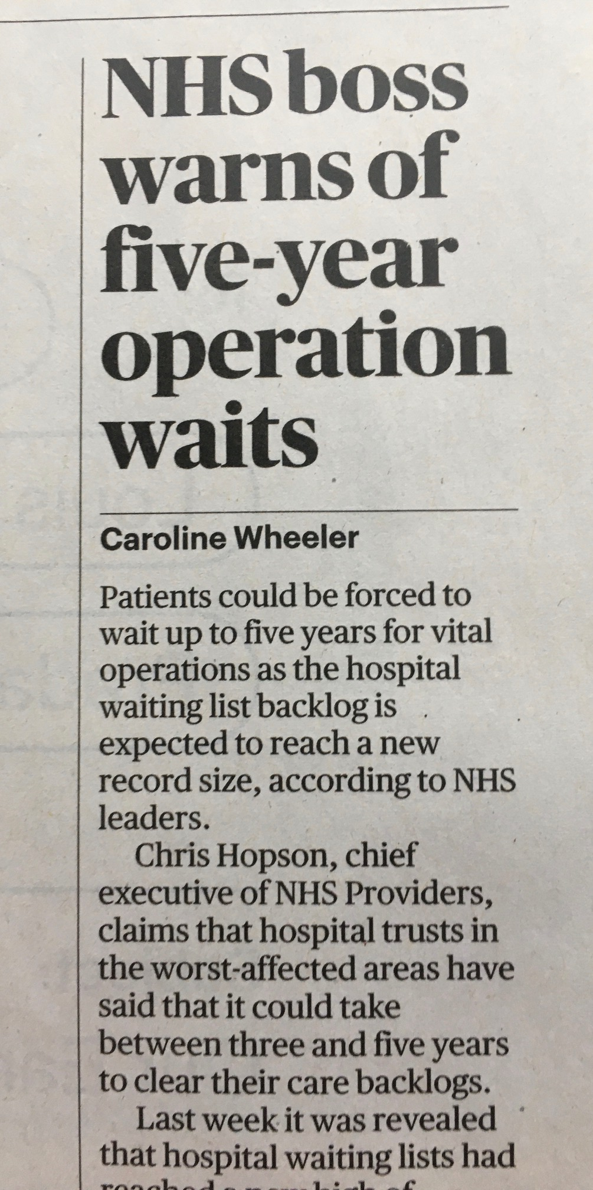

Addressing the care backlog
  Full size of backlog unknown: impact of referral bounce back to come
  Not just elective and cancer backlogs – mental health and community services too
  A very big issue
  “Another waiting list initiative” versus the need to be radical, bold and transformative:
    Radical approach to pinch points
    Expand capacity
    Efficiency / productivity gain via collaborative working
    Reconfigure acute care to avoid elective disruption
    New care models by specialism eg transformative use of technology
  Balancing with other demands
  Being realistic, open and transparent about how much can be achieved how quickly…in spite of difficulties

Slide 9


Getting to a sustainable workforce model
Trying to close the current demand / capacity mismatch by asking staff to work harder and harder is no longer sustainable
Manifesto commitment on 50,000 extra nurses
General workforce expansion: honesty, openness and funding
Does post COVID surge interest in NHS careers provide a mid term solution – funding?
Delivering the People Plan to make the NHS a great place to work with 21st century working conditions, good development opportunities, new roles and fulfilling careers
Serious, targeted, action to manage post COVID retention risk
Pay

Slide 10
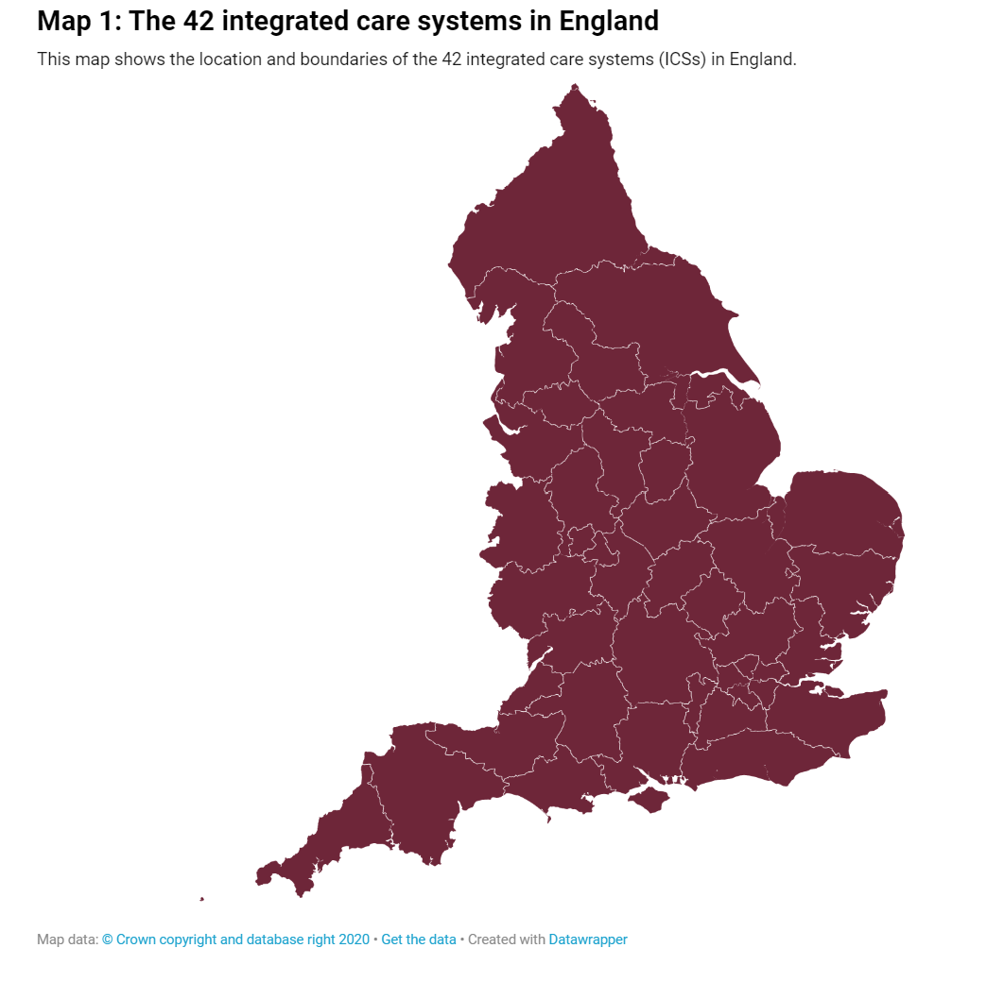
Moving to system working to integrate health and care (1)
2012 Health and Care Act (2012-2014)
  Trusts and foundation trusts deliver secondary care
  Commissioned by Clinical Commissioning Groups (CCGs)
  Oversight and assurance via Monitor and Trust Development Authority – subsequently NHS Improvement
NHS Five Year Forward View / Long Term Plan (2014-2021)
  Creation of Sustainability and Transformation Partnerships (STPs) and then Integrated Care Systems (ICSs): voluntary bottom up partnerships
  Bring together all health and care organisations in 42 defined geographies
New 2021 Act will (2022-):
  Create ICSs as formal statutory organisations that will…
  …Replace CCGs as statutory commissioners and act as money channel for their geographies
  Sit “below” NHSE/I regions and “above” trusts/FTs, places (usually local authority areas) and provider collaboratives (groups of providers working together)

Slide 11
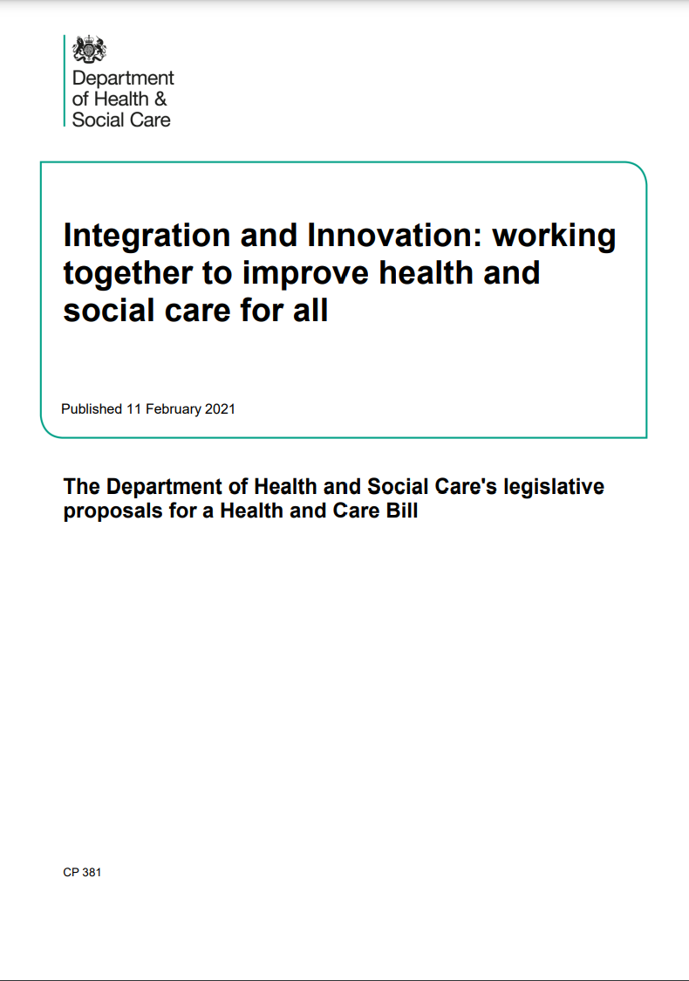
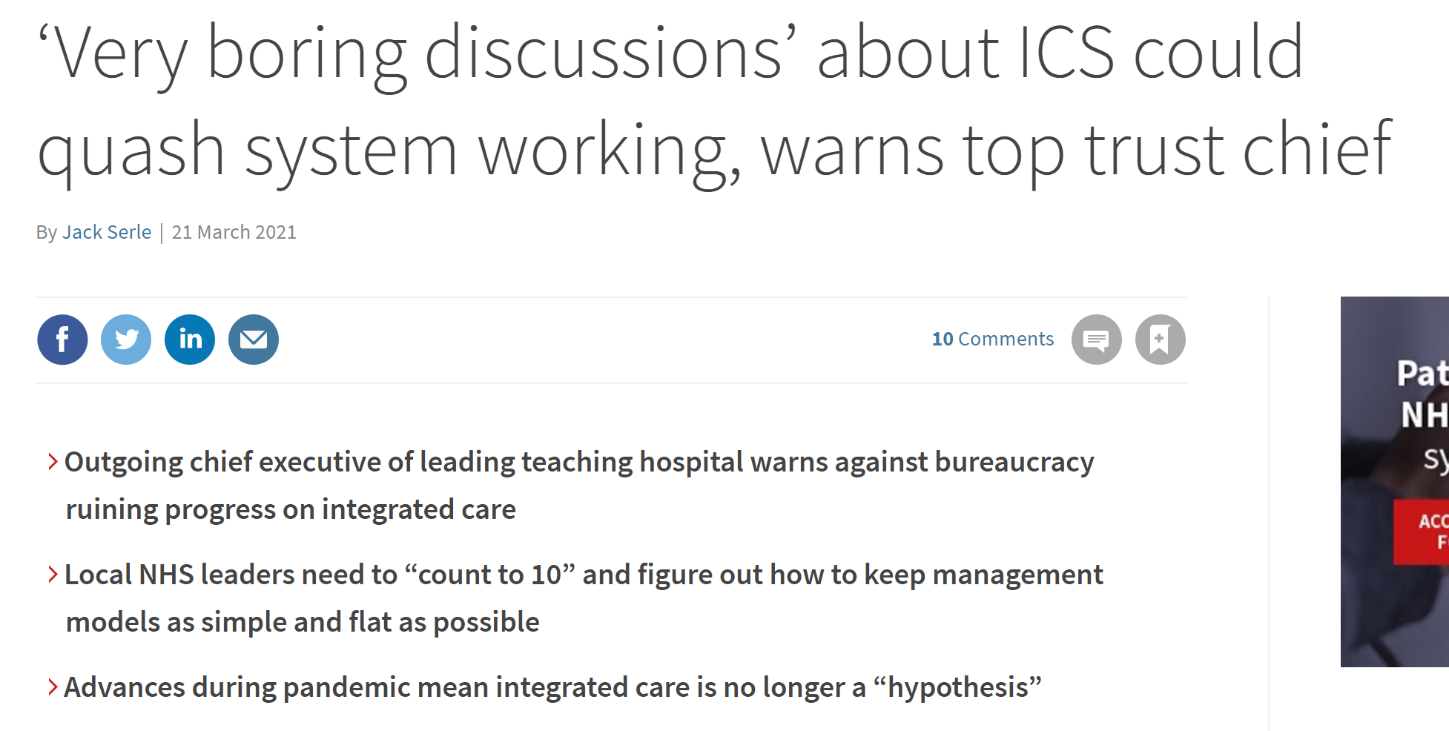
Moving to system working to integrate health and care (2)
Major structural change that will require significant energy and focus to make the approach work locally just as we exit peak COVID
Strong support for the strategic direction of travel....
….And an enabling framework to allow local empowerment to take full account of local needs: heterogeneity single biggest feature of Integrated Care Systems (ICSs)…
….But a lot of detailed “plumbing and wiring” issues to sort with a potentially very crowded pitch:
  ICS governance and the two elements of an ICS
  Making places and provider collaboratives work
  Who does what, how does the money flow and how do accountabilities align with others, for example, trusts
….Pulling senior leadership time and focus onto structure, governance, accountability…
….Potentially away from patients, care, integrating pathways and staff
Impact on governors discussed in final two slides

Slide 12

Making NHS money work
Moving from current model “what you spent last year plus all your COVID-19 costs” to….
…Delivering against a fixed budget requiring efficiency and productivity savings…
…When:
  Provider deficits rose in 2019/20 despite increased NHS funding
  Underlying deficits increasing and underlying recurrent run rates very unclear
  Ability to return to stretching savings unclear
…When we will also be making a major shift from Clinical Commissioning Groups (CCGs)/provider contracting/finances to each ICS being given a fixed budget
…And public finances are going to be very tight
…And Government will be very focused on funding delivery of its manifesto commitments
…And costs of social care reform and unavoidable COVID-19 costs will bring other major budget pressures

Slide 13
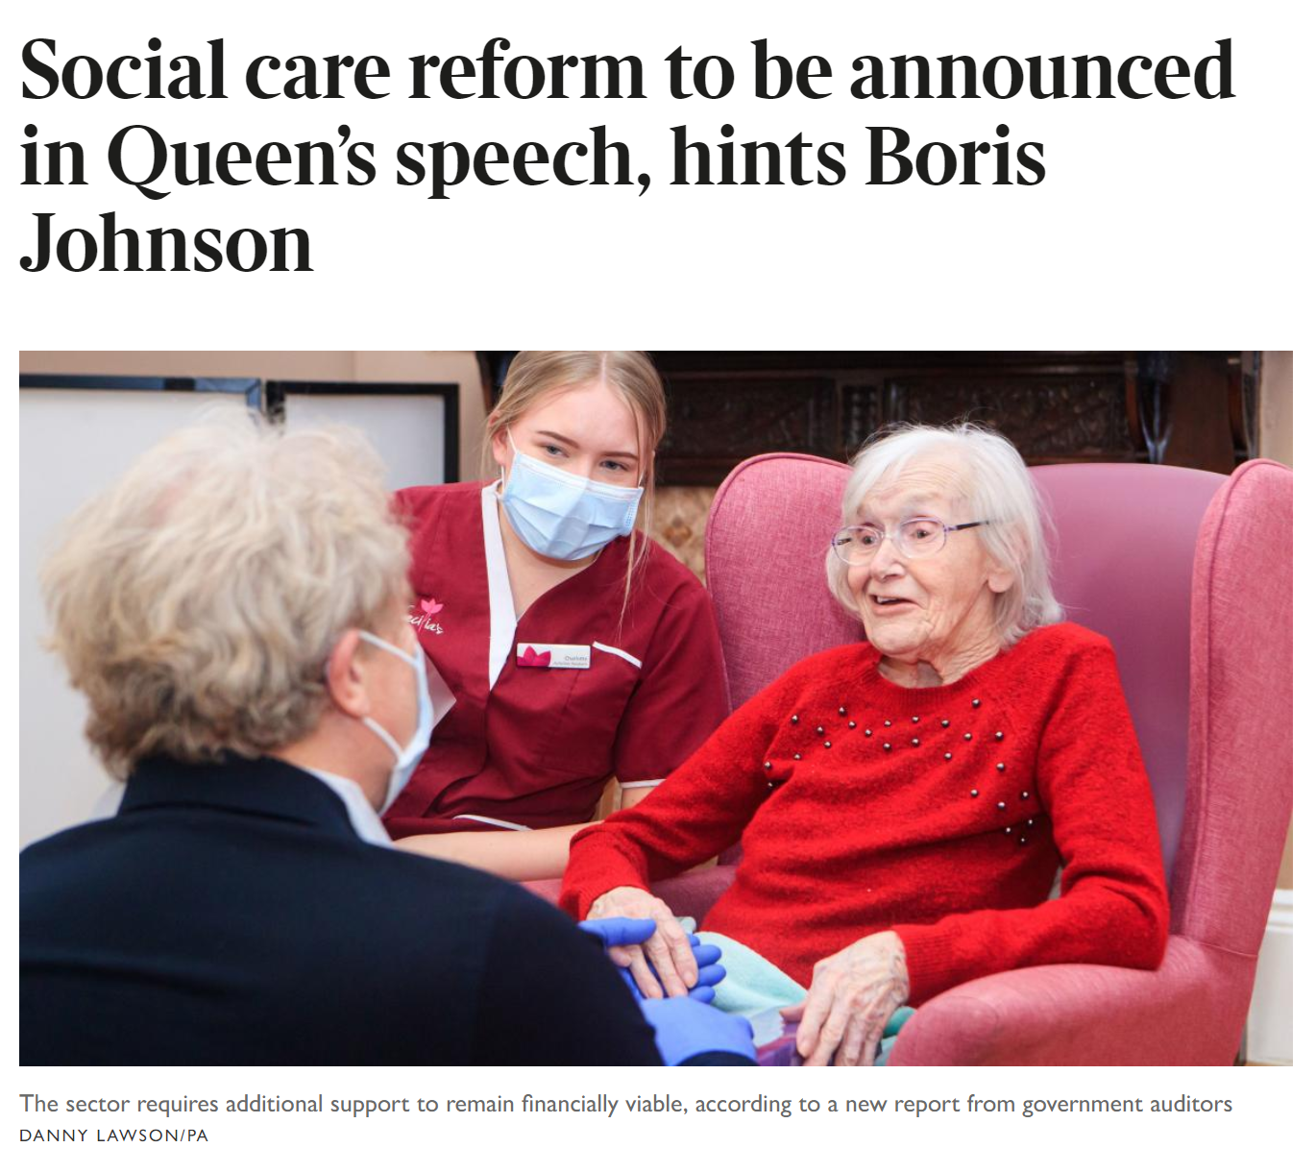
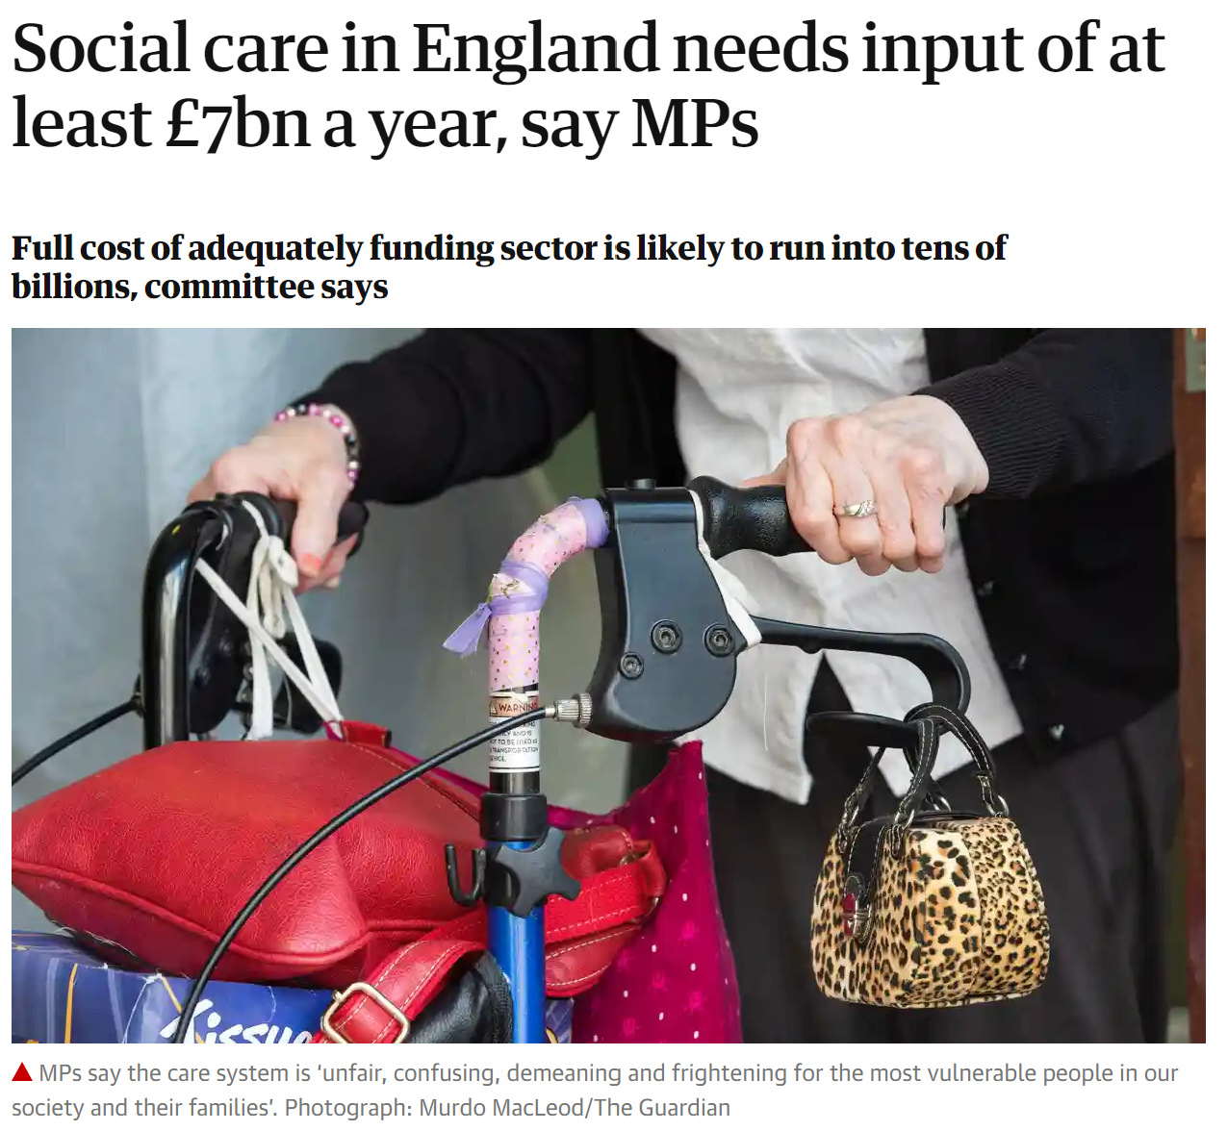
Reforming social care
Multi faceted:
  Personal financial contribution
  Workforce
  Eligibility criteria and service provision / take up
  Local authority funding
  Provider market place
The third rail of British politics:
  Burnham’s Death Tax
  May’s Dementia Tax
The complexity of addressing all that needs to be addressed
The costs involved given the pressures on public finances
PM and Chancellor misalignment? Role of new SoS?
Notes:
Care backlog
Waiting lists: By the beginning of December, there were 224,205 people waiting more than 52 weeks to start hospital treatment in England (compared to 1,467 in December 2019)
Our calls for staff recovery:
Our blog “time to recover”, also published in Public Sector Focus, emphasises the need for recuperative policy when it comes to tackling the care backlog
Chris emphasised how busy the NHS still is in his public comment on the national alert level being moved from 5 to 4 at the end of February
Chris and Saffron’s briefing in February outlined 4 key tests to be met before easing lockdown restrictions: more progress on vaccines, lower COVID-19 case numbers, much less pressure on the NHS and plans in place to contain future outbreaks
Staff wellbeing
COVID vaccine: We have been supporting calls encouraging Black, Asian and minority ethnic staff to take the vaccine; We have been highlighting that the rollout is a success story for the NHS
PPE: Some concern from staff and unions that guidance has not changed in light of new variants of COVID-19, but as the variants transmit in the same way, PHE are confident that existing guidance remains sufficient
Wellbeing: The People Plan 2020/21 has a section on wellbeing, but we have been hearing that members aren’t finding it particularly helpful. Increase in local initiatives on staff wellbeing have been widely reported (and supported); we have been calling for additional funding to ensure that these can remain in place longer-term
Burnout: After the 99% finding in “state of the provider sector”, we submitted to the Health and Social Care Select Committee’s enquiry on “Workforce burnout and resilience in the NHS and social care”; the final oral evidence session was held in late February and we are keeping an eye on the enquiry’s outcome
Future workforce
Potential “mass exodus”: The GMC are particularly concerned and have noted that 30% fewer doctors have left the register than normal over the course of the last year; possibility they will all leave at once, alongside normal attrition numbers + burnt out staff + long term sick leave + annual leave needing to be taken. The situation is the same across other staff groups. We are keeping a close eye for any modelling or data on this issue, and have been warning that increased retention over the past year is a false indicator of workforce numbers
Fully costed and funded workforce plan: We have heard rumblings (from RCN) that next People Plan is unlikely to give the necessary detail for modelling what’s needed in terms of NHS workforce numbers, and in Health and Social Care oral questions in the Commons on 23 February Hancock has said “The time is not quite right now to publish a [workforce] plan”. We disagree and have been calling for a fully costed and funded workforce plan as a matter of absolute priority.
Our line remains that individual resilience can only go so far; what’s really needed to protect workforce wellbeing is enough additional staff not only to cover gaps, but to build flexibility into the system

Slide 14

Risks abound...
We try to deliver too many priorities
There is insufficient money
There’s a workforce crisis post COVID through staff leaving / continuing to ask them to bear an unsustainable workload
We can’t clear care backlogs quickly enough to match political and public expectations
There are further waves of COVID-19 we are insufficiently prepared for, driven by variants
The move to system working ties heath and care in distracting bureaucratic structural knots
We lose control of NHS finances
We flunk proper, full, social care reform again
…BUT WE’VE DONE SOME EXTRAORDINARY THINGS IN HEALTH AND CARE OVER THE LAST YEAR!
Future workforce
Growing concern about service sustainability and staff exodus once the pandemic abates
Fully costed and fully funded workforce numbers plan is vital – we are working with partners on big push on this – new Bill may help

Slide 15

Four Critical Success Factors
1. PRIORITISATION
Too much to do with current workforce capacity and finances…
…Therefore vital to prioritise effectively…
…And managing the political and public pressures that arise when you choose priorities,
2. SPENDING REVIEW SETTLEMENT
Assuming Nov / Dec three year spending review sets financial envelope for rest of Parliament
Very difficult outlook for public expenditure
Therefore vital that priorities are aligned with the financial envelope available…
….Avoiding inevitable tendency to ask NHS to do a lot more than the money allows

Slide 16

Critical Success Factors (2)
3. INNOVATION AND TRANSFORMATION
Increasingly clear that we can’t deliver what’s needed without rapid innovation and transformation…
…Can NHS innovate and transform at sufficient pace to meet these challenges?
Funding for transformation – not just capital for 40 new hospitals
Support for transformation
4. CULTURE AND OPERATING MODEL
Need to harness can do spirit from last 12 months
A new NHS operating model…
Empowering local leaders and clinicians…
Getting past ICS governance set up quickly…into place and provider collaborative led transformation

Slide 17
What does this mean for the role of governor?
Where we are at | Principles to uphold
There are no plans to change the role/duties of governor as set out in the 2021 Bill There are no plans to amend the statutory basis of FTs or trusts However it is clear that the move to system working does have implications for governors. | There is a need for a local accountability arrangements to ensure trusts and systems are responsive to the communities they serve and to act as a counterbalance to the strong pull of the centre There is a need for some form of join up between local accountability at trust and system levels.
Notes:
Looking at each of these questions in more detail we have highlighted some key issues to NHSEI and CQC:
- We are supportive of the overall direction of travel for regulation: more proportionate, reduced burden, and responsive to changes to the health and care landscape including recognising the role of wider system factors in trust-level performance.
Increasingly NHSEI and CQC are needing to consider a more formal role for systems, and what that means for overseeing their responsibilities. Some questions around whether regulating or reviewing systems will introduce multiple conflicting judgements, duplication.
System governance needs to be robust in order to ensure those held to account for decisions / outcomes are the ones who made those decisions – we do not want to see trusts being judged on factors outside of their control.
We have set out the following considerations in answer to each of these questions in our engagement with NHSE/I and CQC via following activity:
Feedback to NHSE/I on emerging system oversight framework
Engagement/feedback to CQC on their draft strategy
Position statement on effective regulation, published on our website
Plug to encourage responses to regulation survey: this was sent to company secretaries – responses extremely valuable in influencing our work in the new year across these areas.

Slide 18
Suggested next steps: working with the grain
Influence and voice:
We will work closely with NHSE/I on an addendum to the Guide for Governors on ‘Your statutory duties’ to place it within the context of system working and to place greater emphasis on representing members and the public
We will argue that NHS trusts be empowered to set up fora such as 'community' councils to act as shadow governor bodies if they wish to. These councils would not have statutory powers as in an FT but would build on what many trusts do now, offer trusts added flexibility and build a more equitable, consistent approach
We will argue for FTs councils of governors to either be given powers to delegate to individual governors to represent the interests of the public at system level or for this to happen on an informal basis. ICSs could set up public engagement councils drawn from FTs and NHS trusts in the system (with nominees from the third sector and local government). This could be permissive legislation or mandatory or informal
NHS Providers will seek to decouple the debate on NEDs engaging at system levels from that about the role of governors; some elements of NHSE/I tend to conflate the two roles inappropriately.
Support:
We will ensure Governwell and other support offers reflect our support for governors, identify and share good practice and adapt as above in this changing landscape.
Notes:
Looking at each of these questions in more detail we have highlighted some key issues to NHSEI and CQC:
- We are supportive of the overall direction of travel for regulation: more proportionate, reduced burden, and responsive to changes to the health and care landscape including recognising the role of wider system factors in trust-level performance.
Increasingly NHSEI and CQC are needing to consider a more formal role for systems, and what that means for overseeing their responsibilities. Some questions around whether regulating or reviewing systems will introduce multiple conflicting judgements, duplication.
System governance needs to be robust in order to ensure those held to account for decisions / outcomes are the ones who made those decisions – we do not want to see trusts being judged on factors outside of their control.
We have set out the following considerations in answer to each of these questions in our engagement with NHSE/I and CQC via following activity:
Feedback to NHSE/I on emerging system oversight framework
Engagement/feedback to CQC on their draft strategy
Position statement on effective regulation, published on our website
Plug to encourage responses to regulation survey: this was sent to company secretaries – responses extremely valuable in influencing our work in the new year across these areas.

Slide 19
THANK YOU
Chris.hopson@nhsproviders.org

