Slide 1
HCV Provider Collaborative The Journey to Establish Excellence in Horizontal Collaborative Working

Slide 2
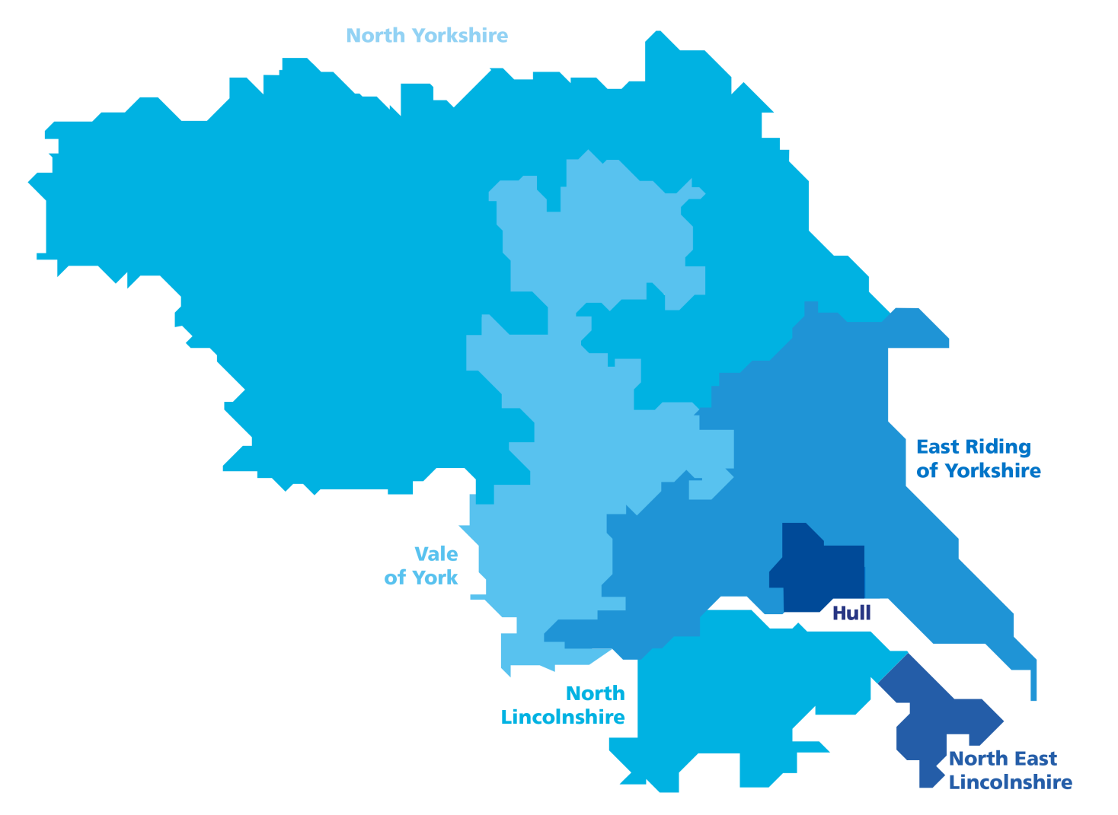
Humber, Coast and Vale
4 acute hospital trusts
(operating across
9 sites)
1.7 million people
Circa 50,000 staff across health and adult social care
3 mental health
trusts
Total budget of
approx. £3.5bn
4 community / not for profit providers
450 care
homes
34 Primary Care Networks
140 home care
companies
2 ambulance trusts
7 hospices
6 clinical commissioning groups (CCGs)
6 local authorities
1000s of voluntary and community sector organisations

Slide 3
HCV Four Collaboratives
1 Acute Collaborative
2 Community Health & Care Collaborative
3 Primary Care Collaborative
4 Mental Health, Learning Disability & Autism Collaborative

Slide 4
Humber, Coast and Vale Health and Care Partnership
Mental Health, Learning Disability and Autism Collaborative Overview

Slide 5
Humber Coast and Vale 2021/22 Priorities
Autism and Learning Disabilities
Children and Young People’s Mental Health
Community Mental Health (IAPT, Dementia and SMI Health Checks)
Urgent and Emergency Mental Health Care
Building Mental Health Resilience
Perinatal Mental Health and Maternity Mental Health Services
Suicide Prevention
Individual Placement Support

Slide 6
HCV MH, LDA
Weekly Groups established to develop 2021/22 planning, feeding work through our governance
MH and LDA leads Weekly Planning Call
MH and LDA Planning Task and Finish Group

Slide 7
HCV planning approach for Mental Health, Learning Disabilities and Autism
Planning and investment decisions must be based on population health needs. A maturing system can recognise the need to invest resource where it is needed in the short term and re balance finances across the full term of the plan or SDF funding timescale.
We will take a multi year approach, ensuring that priorities are developed with a clear strategic timeline (3 year approach). This will ensure that we can flex and accelerate plans as necessary when funding becomes available.
Levelling up – we want our investments to enable all of our populations across HCV to be able to access the same standard of mental health, Learning Disabilities and Autism support.
We want to make LD and Autism a priority, deliver on recently developed 3 year plans and ring fence funding for this purpose.
Our planning needs to be a collaborative process, with open and transparent communication around expected levels of investment, recognition of both local priorities and LTP deliverables. Local governance processes need to be incorporated.

Slide 8
Success
Governance structures & agreements
Several services & pathways delivered across HCV
Early adopters of children, young people pathways
Commissioning Lead Provider model
Clinical Assembly

Slide 11
We have to continue to overcome some challenges to develop Collaboratives
Trusts wrestling with sovereignty of governance v collective governance
Relationship between horizontal working and vertical working (Collaboratives v Place)
Expectations of funding flows may be different
The importance of creating a concept of responsibility rather than accountability (the Collaboratives are an integral element of the ICS governance and not separate)
Capacity to operate at each level - ICS, geographic partnership, place and neighbourhood

Slide 12
HCV Collaboratives Successes
1 Four operational Collaboratives now running
2 Positive mindset within the ICS as to the value of horizontal working
3 Providers prepared to take ownership of key programmes of work
4 Recognition of the need to have shared access to data
5 Ongoing process to develop the Collaboratives and to ensure their relationship with place based work is clear
6 Commissioned a scenario planning workshop to test out the operating model
7 Engagement with Local Authorities

Slide 13
Next Steps
Develop our Collaboratives
Collaborative Assembly
Scenario events with funding flow - out come focussed

